Slide 1
North Korea
AUTHOR’S NAME
INSTITUTION AFFLIATION
date
I

Slide 2
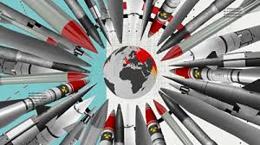
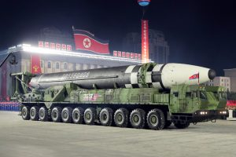
North Korea: Nuclear Weapon
Intercontinental-range ballistic missile, hwasong-15.
Persistence improvements of nuclear weapons.
Notes:
North Korean has shown great effort in launching of nuclear weapons.
The country got to the climax after it revealed the intercontinental-range ballistic missile, hwasong-15.
further president Kim Jong also revealed another missile that appeared to be a large two-stage liquid propellant ICBM.
Despite, the economic sanctions, the country still have the ability to consistently improve their nuclear weapons.
Why would North Korean show the persistence in investing in the nuclear weapons compared to economic developments?

Slide 3
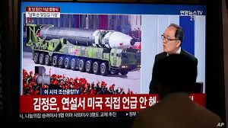
Persistence in investment and launching of nuclear weapons
Growth and qualitative capabilities.
Nuclear deterrent in the face of U.S and missile defenses.
Notes:
The persistence on nuclear weapon improvement its to show the super power countries their continued growth and qualitative capabilities.
In the celebration of the 75th year anniversary of Workers Party of Korea, the president revealed ICBM design.
The missiles were largest road-mobile missiles on integrated launchers seen anywhere in the world and ever seen in North Korea.
That demonstrated their quantitive capabilities of nuclear weapon.
Also, the reason for considering missile launches to render credible nuclear deterrent in the face of U.S and missile defenses.

Slide 4
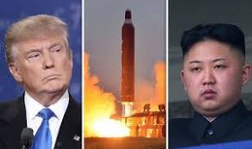
Diplomacy
Imposed sanctions over the weapons
President Kim meeting Donald Trump on diplomatic resolutions.
Why has China come to support of North Korea in the nuclear weapon launches? Does China intend to join the rivals of U.S due to trade wars?
Notes:
The North Korean president met President Donald Trump in signing diplomatic agree about the nuclear weapons.
At first, China joined the US and other nations in imposing sanctions over the nuclear weapons.
In 2018 to 2019, the two presidents had five meetings. Xi said “…intent to successfully defend, consolidate and develop the China-Korea relations…”.
Why has China come to support of North Korea in the nuclear weapon launches? Does China intend to join the rivals of U.S due to the ongoing fights between the two countries?

Slide 5
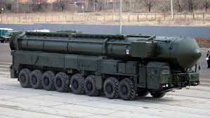
Significance
Country preparedness to face their enemies.
Has the country identified an external threat for such comments or forming alliance with China?
Notes:
The launches and improvements of the ICBMs demonstrates the country preparedness to face their enemies.
As much as President Kim, states that they will not misuse the weapons unless external forces demand retaliation. The coming together with China seem a preparation of war.

Slide 6
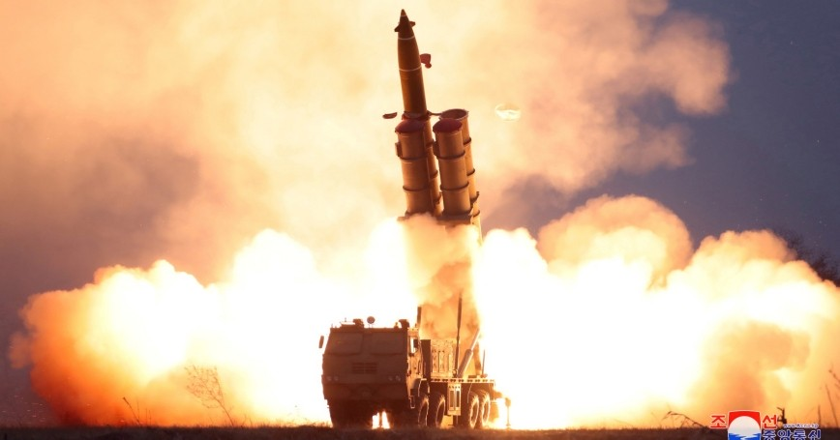
Problem
US major threat.
Does the US nuclear weapons and missile defense match the quality aspect demonstrated by North Korea?
Effects of neighbor countries.
Notes:
The nuclear weapon is a threat to the U.S and missile defenses but equally, Japan and South Korea the immediate neighbors are at risk.
After the announce of a launch of a weapon, at the beginning of the year by Kim, the Japan unwelcomed the idea since they though they would launch within third vicinity and affect the world Olympics. Could Japanese claims be true?

Slide 7
Japan-South Korean Alliance
Which factors are propelling the Japan-South Korean to rebuild their relationship?
Threat of China military base and North Korea missile launches.
Leave the history and work for the future of their countries.
Notes:
The growth of China’s military base has been a threat to Japan. Therefore, there is need for alliance with their historical rivals, South-Korea.
Does these alliances of countries meant to prepare for a war?
Also, according to Article 9 of Japan’s constitution it renounces use of war or use of force in settling disputes. Does that contradict peace resolution method by taking rivals strategy?

Slide 8
References
The Straits Times, (2020, October). China's Xi Jinping says intends to deepen relations with North Korea: KCNA Retrieved from: https://www.straitstimes.com/asia/east-asia/chinas-xi-jinping-says-intends-to-deepen-relations-with-north-korea-kcna
Panda A., (2020, October). A Nuclear North Korea’s Wake-up Call. A spectacular pre-dawn parade on Saturday served to remind the world of North Korea’s continuing missile progress. Retrieved from: https://thediplomat.com/2020/10/a-nuclear-north-koreas-wake-up-call/
Hornung J.W., (2018).Revising Japan’s peace constitution: much ado about nothing. Retrieved from: https://warontherocks.com/2018/03/revising-japans-peace-constitution-much-ado-about-nothing/
Aoki N. , (2020). Japan's North Korea Challenge in 2020. Retrieved from https://www.rand.org/blog/2020/01/japans-north-korea-challenge-in-2020.html

